Slide 1


Stress Management Techniques For
Healthy Work Life Balance
Presentation By:-
1. Yash Pardhi
2. Monali Asatkar
3. Kunal Baghele

Slide 2
Content
Understanding Stress
Types of Stress
Stress Management Techniques
How to Overcome ?

Slide 3

Understanding Stress
What is stress
Types of stress
Common causes of workplace stress
Recognizing the signs of stress

Slide 4

Types of Stress
Eustress
Distress

Slide 5






Common Causes Of Work-Related Stress
High Workload
Tight Deadlines
Conflicts with Colleagues or Superior
Lack of Job Security
Lack Of Support
Inadequate Resources

Slide 6
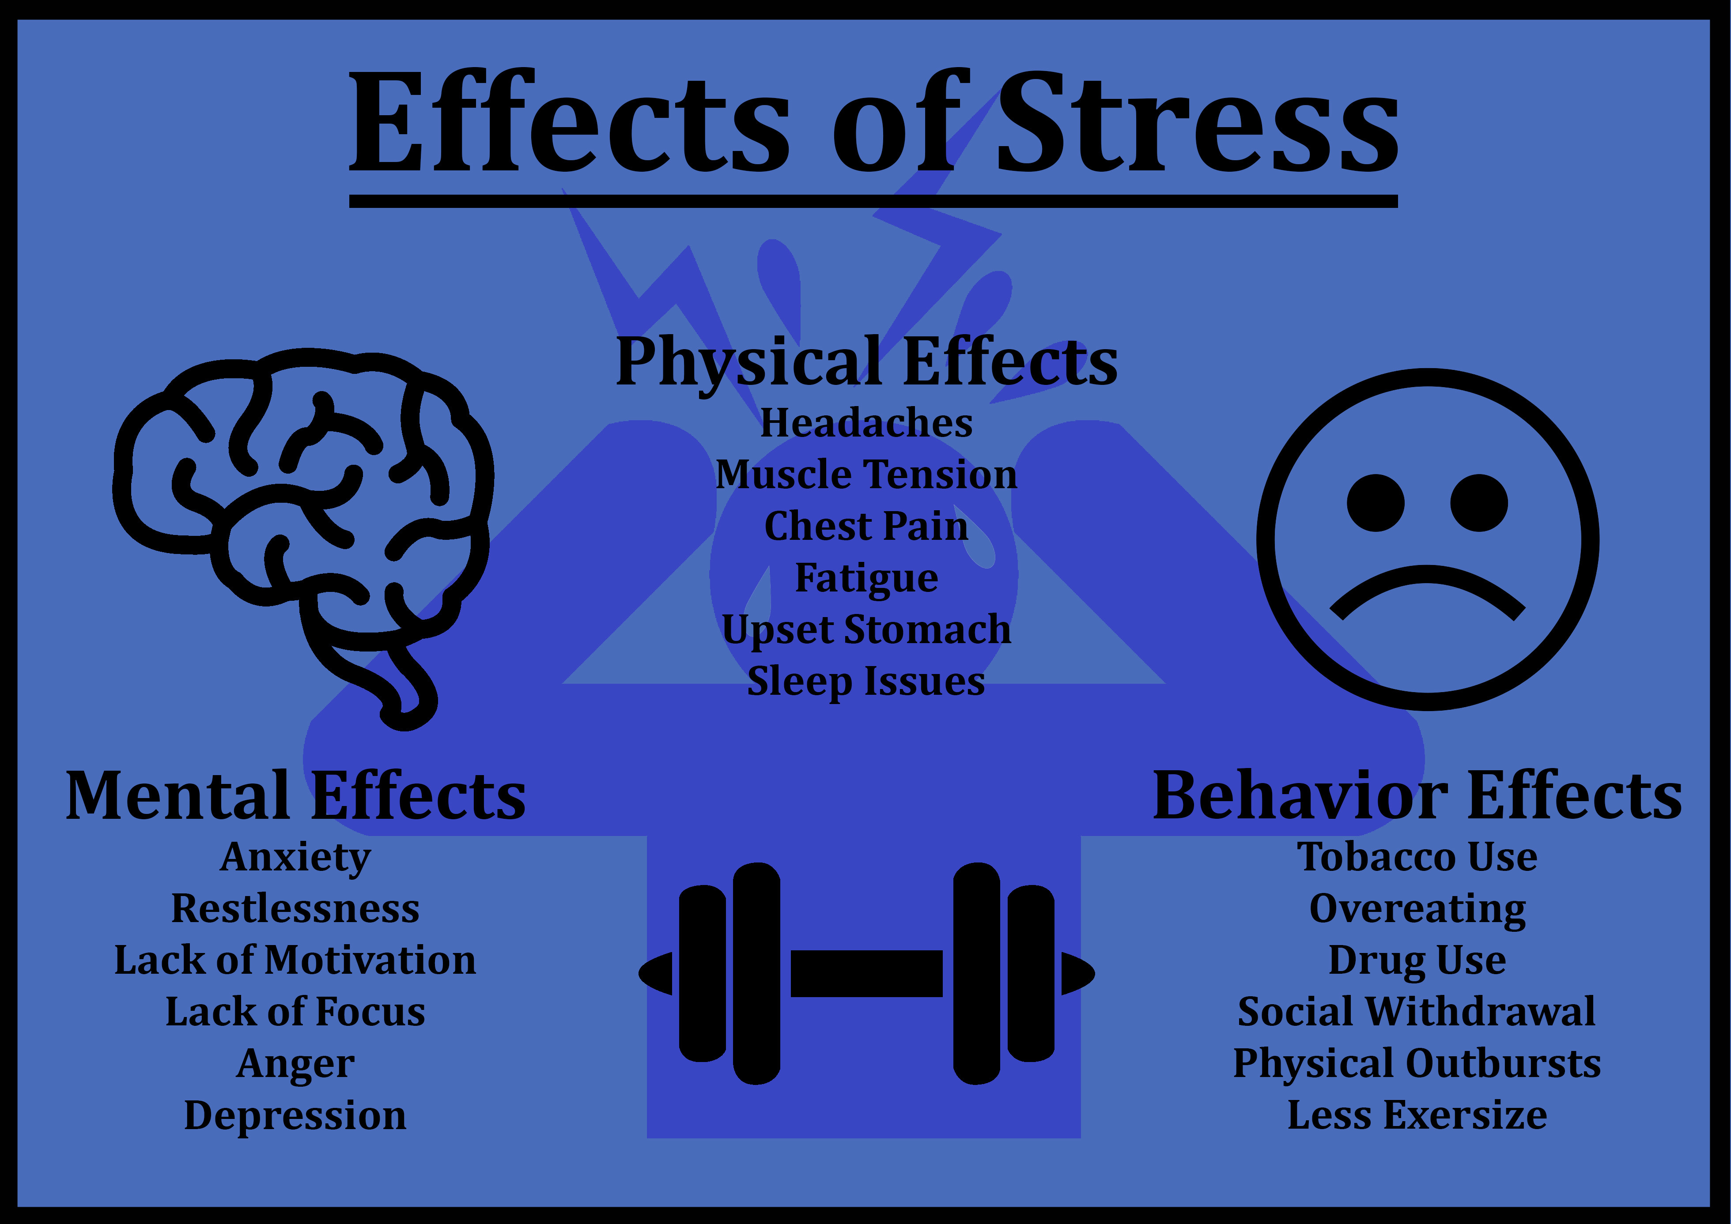
Recognizing Signs Of Stress
Physical Signs
Emotional Signs
Behavioral Signs

Slide 7
Stress Management Techniques
Time Management:
Prioritization and planning
Setting realistic goals
Mindfulness and Relaxation:
Deep breathing exercises
Meditation and mindfulness practices
Quick relaxation techniques

Slide 8
Physical Activity:
Importance of regular exercise
Desk exercises and stretches
Walking breaks
Healthy Lifestyle Choices:
Balanced nutrition
Adequate sleep
Hydration

Slide 9

How to overcome ?

Slide 10
Setting Boundaries
Setting Boundaries at Work and Home
Work Boundaries
Home Boundaries
Tips to set boundaries

Slide 11
Technology and Disconnecting
Limiting Screen Time
Managing Email and Notifications
Importance of Disconnecting to Recharge

Slide 12
Thank You

